Slide 1
Growth Mindset
By: ELDERBERRY
The European Commission’s support for the production of this publication does not constitute an endorsement of the contents, which reflect the views only of the authors, and the Commission cannot be held responsible for any use which may be made of the information contained therein.

Slide 2
Index
01
What is Growth Mindset
02
Ways to Nurture a Growth Mindset
03
Why Young People Need Growth Mindsets

Slide 3
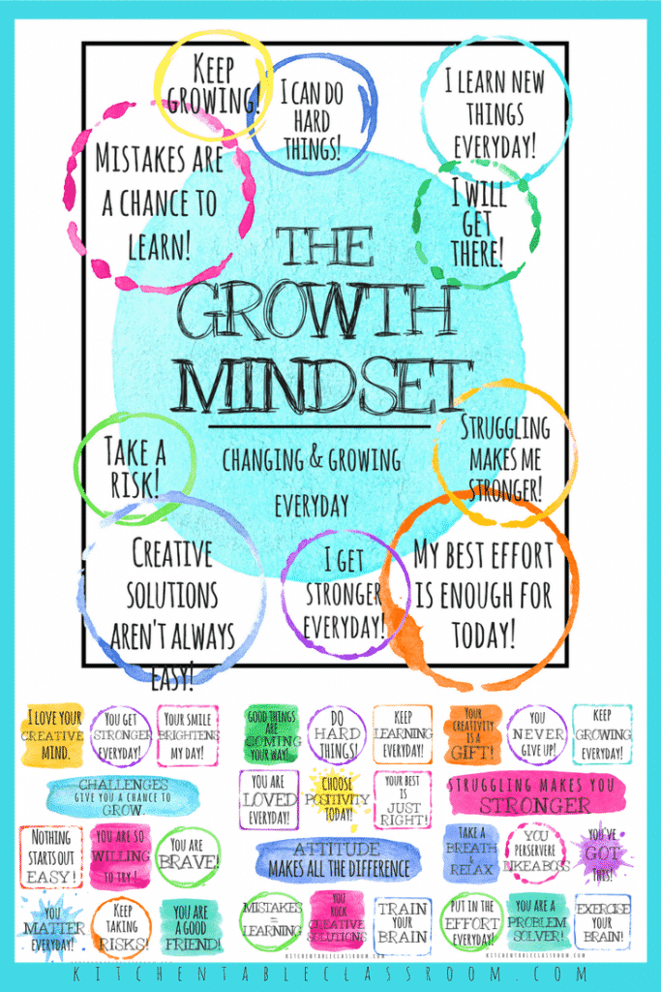
A mindset is the series of beliefs people hold about themselves, their self-perception. A growth mindset is a belief that you can develop your skills and talents through hard work, the right strategies, and guidance from others.
The term growth mindset was coined by American psychologist Professor Carol Dweck in her 2006 book Mindset: The New Psychology of Success. Her work explored how an individual’s underlying belief about their intelligence and ability to learn could impact their performance.
Her studies show that those who believe they can develop their talents tend to achieve more than those who feel their abilities are innate and fixed. Those with a growth mindset see opportunities instead of obstacles, choosing to challenge themselves to learn more rather than sticking in their comfort zone.
As Professor Dweck explains it: “This growth mindset is based on the belief that your basic qualities are things you can cultivate through your efforts. Although people may differ in every which way—in their initial talents and aptitudes, interests, or temperaments—everyone can change and grow through application and experience”.
What is a Growth Mindset

Slide 4
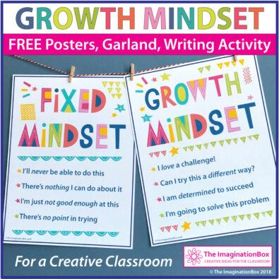
Growth mindset vs Fixed mindset!
The opposite of a growth mindset is a fixed mindset. While the former is focused on self-improvement and development over time, a fixed mindset is essentially the belief that abilities are innate and fixed from birth.
Those with a fixed mindset believe that each person inherits qualities such as intelligence, talents, and personality characteristics. Those who feel that their qualities are unique to their genetic makeup generally also feel that these characteristics stay stable throughout their lives.
According to Dr Dweck’s original research, those with a fixed mindset are more likely to seek opportunities to demonstrate strengths rather than those that could expose weaknesses. She goes on to say that such an approach to life can backfire. Although they take fewer risks, people with a fixed mindset can miss out on opportunities and chances to learn and grow.

Slide 5
A Culture of Practice
An important concept of having a growth mindset is realising that learning is a process and each moment is an opportunity to practise and improve. Growth occurs over time, and this is where it’s hard to have a growth mindset. We want perfection, a first class, 100%. We fall into the trap of saying, “I’m not creative. I can’t draw. I’m not good at science.” when that is NOT true! You simply haven’t practised enough.
Inherent in this culture of practice are moments of failure followed by a decision to persevere or give up. When working with NEETs this is where character development occurs. Youth (and adults too!) that learn to view failure as just another step in the learning process have achieved a growth mindset. Once you grasp that there is no limit to what they can achieve!
Ways to Nurture a Growth Mindset

Slide 6
Shift in Vocabulary!
Cultivating a growth mindset requires a change in vocabulary to bring about a focus on the process of growth and improvement. Even responses to moments of success can be shifted.
Consider a time when you see a little child building something with Lego When the child completed the task, you could say, “Great job, you did it! You got it right!” However, to nurture a growth mindset you would say, “Wow! You tried four different times to build that house. I noticed you didn’t give up. You kept working until you got it! Well done!”
Another example: A youngster confronts a maths problem (insert any task or skill specific to the person) that they successfully complete. Instead of solely praising their achievement, bring attention to the process. “Great work! I see the practice you put in is really paying off! I wonder what will happen if you keep practising?”

Slide 7
Ten ways to develop a growth mindset
Gently redirect negative thoughts to empowering thoughts.
Reframe mistakes as lessons.
It’s not a problem, it’s an opportunity.
Keep learning and growing.
Acknowledge your accomplishments.
6. Replace judgement with compassion.
7. Value the attempt more than the result.
8. Take baby steps.
9. Leave your comfort zone.
10. Have a “I don’t have (goal) YET” attitude.

Slide 8
Rationale and benefits of having Growth Mindsets
With a Growth Mindset, you are more realistic in focusing on doing the hard work. This means that the chances of you doing the hard work are much higher than when you have a Fixed Mindset. That means that you will be more successful if you have a Growth Mindset
A Changing World – Need for New Thinking
With technology and business models changing rapidly, embracing a growth mindset is vital to career success. Workers will need to continuously learn new skills to remain competitive as automation technologies, including artificial intelligence, become more prevalent.
Entrepreneurial competencies
Entrepreneurial competencies are the knowledge, skills and attitudes that help a person start a company. These competencies encapsulate the mindset and know-how for identifying opportunities, creative problem solving, taking initiative, communicating, reflecting, adapting, and attitudes such as curiosity, open-mindedness, proactivity, flexibility, determination, and resilience. While some believe that entrepreneurs are born, there is robust evidence that such entrepreneurial competencies and “the entrepreneurial mindset” can be taught.
Why young people need a Growth Mindset

Slide 9
Growth Mindset
A growth mindset is the belief that your skills and abilities are not set in stone. Just as mighty oaks grow from tiny acorns, our talents might start small, but they have the potential to grow huge.
Fixed mindset
People with a fixed mindset are more likely to believe that their ability and intelligence can’t be changed; that they're either good at something or not.
Open-mindset
A growth mindset requires leaders to be more inclusive to the unique needs and perspectives of others. Growth requires more than profits; it requires a clear understanding of human capital assets.
Inclusion and promote individuality Inclusion is a system for making sure organisations are welcoming at every level to every individual. Inclusion is about finding like-mindedness in our differences and embracing individuals’ unique ideas and ideals.
Cultivate Resilience
Individual with growth mindset, then take the time and make the effort to develop it. Persist and opportunities will come.
Glossary

Slide 10
Quest 1: What is a Growth Mindset
Introduction: What’s this all about?
Task: What’s the activity?
A growth mindset, as conceived by Stanford psychologist Carol Dweck and colleagues, is the belief that a person's capacities and talents can be improved over time
Growth mindset describes a way of viewing challenges and setbacks. People who have a growth mindset believe that even if they struggle with certain skills, their abilities aren’t set in stone. They think that with work, their skills can improve over time.
You are to undertake a short quiz, follow the link here to do the Quiz: Growth Mindset Quiz – Is Your Mindset Fixed Or Growth? (wdhb.com)

Slide 11
Quest 1: What is a Growth Mindset
Process: What am I going to do?
Learning outcomes: What will I learn?
Watch the Video Growth Mindset by Carol Dweck (founder of the Growth Mindset) concept, that will provide you with a visual explanation of what a growth mindset is and what it entails to develop on. That video will help you with the follow up questions, remember the follow up questions are an addition and you can complete them on your own or with a friend/colleague.
Understanding and managing interactions and conversations in different socio-cultural contexts and domain-specific situations.
The planning, organising, monitoring, and reviewing of one’s own learning.
Developing creative ideas, synthesising and combining concepts and information from different sources in view of solving problems.

Slide 12
Quest 1: What is a Growth Mindset
Conclusion: What will I take home?
Having a growth mindset means recognising our ability to change who we are, what we know, and how we think. Our personal qualities and abilities are not static; they remain open to change from outside and within.
For many, this may offer a significant shift in their outlook of who they are and can become. Recognising our capacity for growth and development places accountability on ourselves to take charge and develop in the direction of our choosing.
When working on ourselves, we should review the theory and try out the questions and exercises to understand which mindset you rely on. Then identify what changes you wish to make to enter the growth zone. The choice is ultimately yours, but a growth mindset may open new opportunities for you that may have previously seemed impossible.

Slide 13
Quest 2: Ways to Nurture a Growth Mindset
Introduction: What’s this all about?
Task: What’s the activity?
Our minds can be our biggest assets or our biggest obstacles in life. You can cultivate beliefs that work for you and lead to your success, or they can work against you and your best interests without you even realising it.
When you believe that your potential is unlimited and that good things are always coming your way, you are practising a growth mindset.
You have come for a job interview in a fast-paced product design company you have been set the following activities:
The Crumpled Reminder Activity – This brief exercise invites you to write down a recent setback you’ve experienced then reassess your understanding of failure.
A Cafe Discussion Task – These prompts encourage a discussion of the opportunities that arise from failure.
The Mistake Game – This exercise is designed to help young people talk about mistakes openly, helping them to embrace them and use them for learning.

Slide 14
Quest 2: Ways to Nurture a Growth Mindset
Process: What am I going to do?
Learning outcomes: What will I learn?
You can work in a small group or on your own and go through the ways to nurture your mindset
Awareness of potential biases in the data and one’s personal limitations, while collecting valid and reliable information and ideas from diverse and reputable sources.
Awareness of and confidence in one's own and others’ abilities to learn, improve and achieve with work and dedication.
Understanding that learning is a lifelong process that requires openness, curiosity, and determination.

Slide 15
Quest 2: Ways to Nurture a Growth Mindset
Conclusion: What will I take home?
So, can you develop a growth mindset? If you tried one of the activities, we suggested you will see you become more resilient when dealing with problems.
Research suggests that with the right attitude, we can improve the way we deal with life’s difficulties.

Slide 16
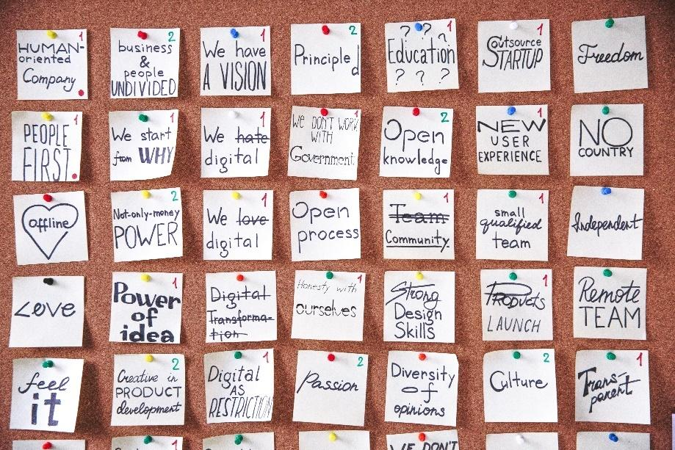
Quest 3: Why Young People Need a Growth Mindset
Introduction: What’s this all about?
Task: What’s the activity?
Having a growth mindset can have real benefits. It helps people reframe their approach to challenges and stay motivated to work to improve skills. Instead of thinking “I can’t do this,” they think “I can’t do it yet.”
Having a growth mindset means believing that learning is a lifelong process, that success isn’t limited to our academic life, and that we can always learn something new. However, if you’re constantly second-guessing yourself and you’re already convinced that you can never grow any further in your career or personal life, then you need to understand why it’s essential to have a growth mindset.
You have come for an interview in a fast-paced product development company, and you are asked “why is it important to have a growth mindset?” You are required to do a 15 minute presentation either on Powerpoint or use flipchart.

Slide 17
Quest 3: Why Young People Need a Growth Mindset
Process: What am I going to do?
Learning outcomes: What will I learn?
To do your 15 minutes presentation first you will need to:
Step 1- explain what Growth Mindset is, activity 1 in this module will provide you with some valuable insight (3 mins)
Step 2 - look at activity 2 in this module that provides details on how to develop growth mindset; summarise this in your presentation (2 mins)
Step 3 - spend the remaining time in your presentation in explaining why it is important to have a growth mindset (10 mins)
I can judge my strengths and weaknesses and those of others in relation to opportunities for creating value.
I can critically evaluate the risks associated with an idea that creates value, taking into account a variety of factors.
I actively face challenges, solve problems and seize opportunities to create value

Slide 18
Quest 3: Why Young People Need a Growth Mindset
Conclusion: What will I take home?
Having a growth mindset can be highly beneficial for individuals, organisations, and communities.
As you learned above, there are many reasons why it is important to have a growth mindset. The first reason is that this mindset allows you to take calculated risks and make changes – giving you more confidence in your decisions and actions so that you never have to worry about your past mistakes holding you back.
Second, a growth mindset helps you to improve all areas of your life. It allows you to become a better student, a better parent, a better employee, and even a better citizen.
The final reason why having a growth mindset is essential is because it helps you to realise your full potential and live a happier and more fulfilling life. With a growth mentality, you’ll be able to see your weaknesses as strengths and use them as a stepping stone toward your goals!

Slide 19
Self-assessment
Multiple-choice questions: consolidate your learning
Question 1: People with a growth mindset like thinking of original ways to do things
a) True
b) False
Question 2: People with Growth mindset when they make a mistake, they try to figure out some learning.
a) True
b) False
Question 3: People with Growth mindset see mistakes as valuable learning opportunities.
a) True
b) False

Slide 20
Self-assessment
Multiple-choice questions: consolidate your learning
Question 4: Your personality is pretty much set in stone and there isn't much you can do to change it.
a) True
b) False
Question 5: People with Growth mindset like trying new things, even if they don’t do them well.
a) True
b) False

Slide 21
Self-assessment
Multiple-choice questions: solutions
Question 1:
People with a growth mindset like thinking of original ways to do things
True
Question 2:
People with Growth mindset when they make a mistake, they try to figure out some learning.
True
Question 3:
People with Growth mindset see mistakes as valuable learning opportunities.
True

Slide 22
Self-assessment
Multiple-choice questions: solutions
Question 4:
Your personality is pretty much set in stone and there isn't much you can do to change it.
False
Question 5:
People with Growth mindset like trying new things, even if they don’t do them well.
True

Slide 23
Summing up
A growth mindset means one embraces challenges, persists in the face of setbacks, takes responsibility for their words and actions, and acknowledges that effort is the path toward mastery. It is basically the reason why “practice makes perfect."
While having a growth mindset can be helpful for everyone in general, it is especially important for young people who are still in the early stages of their education and careers, to build the habits and attitudes that will serve as a foundation for the years ahead.
A
B
The definition of growth mindset is much simpler than it sounds. In a nutshell, it is the belief that skills and intelligence can be improved with effort and persistence. People with a growth mindset embrace challenges, stay resilient in the face of difficulties, learn from constructive criticism, and seek out inspiration in others’ success.
C
D
Having a growth mindset means believing that learning is a lifelong process, that success isn’t limited to our academic life, and that we can always learn something new.

Slide 24
Thank you!
Continue your training path at www.projectspecial.eu!

