Slide 1
Social media management
By: Internet Web Solutions
The European Commission’s support for the production of this publication does not constitute an endorsement of the contents, which reflect the views only of the authors, and the Commission cannot be held responsible for any use which may be made of the information contained therein.

Slide 2
Index
01
Social media
What are, types and what are the most popular.
02
Uses of social media in the 21st century
Personal, professional and work use.
03
The hidden side of social media
Risks, offences and recommendations.

Slide 3
Social media
What are social networks?
The concept of "social network" has been used to analyse interactions between individuals and groups of people, even societies, since the end of the 19th century. In 1990, with the emergence of the Internet, the idea of social networking moved to the virtual world. In 2004, Facebook appeared, probably the world's best-known social network (you have probably seen the film "The Social Network" directed by David Fincher, which tells the story of Mark Zuckerberg, the creator of Facebook!), but even before that, there were already other social networks on the Internet.

Slide 4
Social media
Types of social media
Relationship-based social media
Entertainment social media
These are social networks that aim to connect people, such as Facebook.
In this type, the main objective is to consume digital content, such as YouTube or TikTok.
Niche social media
Professional social media
These target specific audiences, such as TripAdvisor.
These are those whose objective is to create professional relationships between users, such as LinkedIn.
However, this typology is very open, and some social medias could even fall into several categories; for example, Instagram today connects millions of people, and is in turn used to consume entertainment in the form of videos and pictures.

Slide 5
Social media
Most popular social networks
Facebook. Created in 2004 with the aim of connecting people to share information, news, videos and photos. It has 2.9 billion active users in 2022.
YouTube. Created in 2005, it is the social network by excellence for video sharing, and gives its name to the profession of "youtubers". More than 2.5 billion active users by 2022.
Instagram. Launched in 2010, it is mainly used to share videos and photos. 1.5 billion active users by 2022.
Twitter. Founded in 2006, it is a microblogging social network, with short "tweets" of a maximum of 280 characters. More than 440 million active users by 2022.
LinkedIn. Professional social network founded in 2002, with 310 million monthly active users by 2022.

Slide 6
Social media
Most popular social networks
TikTok. Launched in 2016, it is used to share short videos, where music, editing and effects predominate. It already has 1 billion active users by 2022.
Pinterest. Created in 2010, it is a platform for sharing and discovering visual content. It has 444 million active users in 2022.
Reddit. Started in 2005, it is a news and social bookmarking site with sub-communities or "subreddits". In 2022 it has 430 million monthly active users.
Twitch. Launched in 2011, it is one of the largest live streaming platforms. It has more than 140 million monthly active users in 2022.

Slide 7
Uses of social media in the 21st century
Personal use
Nowadays, we could say that the main use of social networks is for personal use: they allow you to keep up with the latest news, meet new people, keep in touch with people you already know from anywhere in the world, interact with different types of publications, and be entertained by a huge amount of audiovisual content.
Social media is fun, open and dynamic, but remember to use it responsibly - don't spend your whole day refreshing your Instagram homepage!

Slide 8
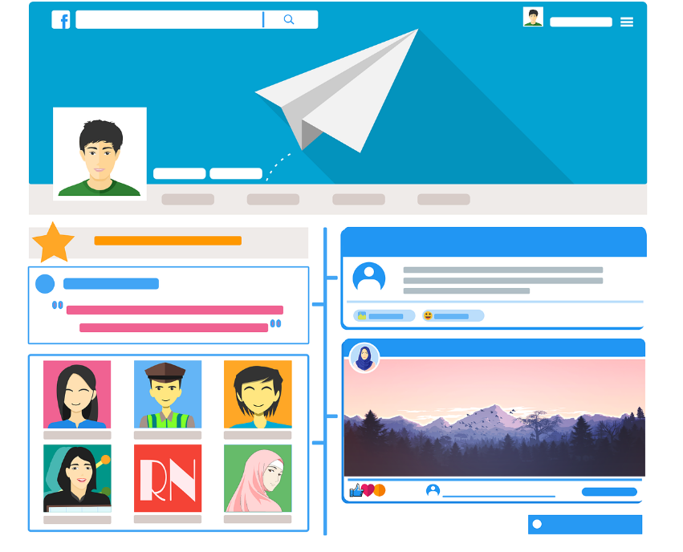
Uses of social media in the 21st century
Professional use
In addition to the personal use of social networks, they can also be used professionally, whether for job search, business networking, or as a corporate social network. For networking, there are social networks such as LinkedIn, Xing or Womenalia, while from the point of view of a company, it can be present in any social network that has the public to which its products or services are addressed, as a way to reach new and current customers.

Slide 9
Uses of social media in the 21st century
Professional use
As a result of the rise of social media, new professions have been created, such as the "community manager" or "social media manager", who work managing and administrating companies' social networks.
Social networks are also a valuable source of information, allowing researchers to extract highly relevant data for sociological studies that focus on people's social behaviour, as well as allowing companies themselves to learn valuable information for their business.

Slide 10
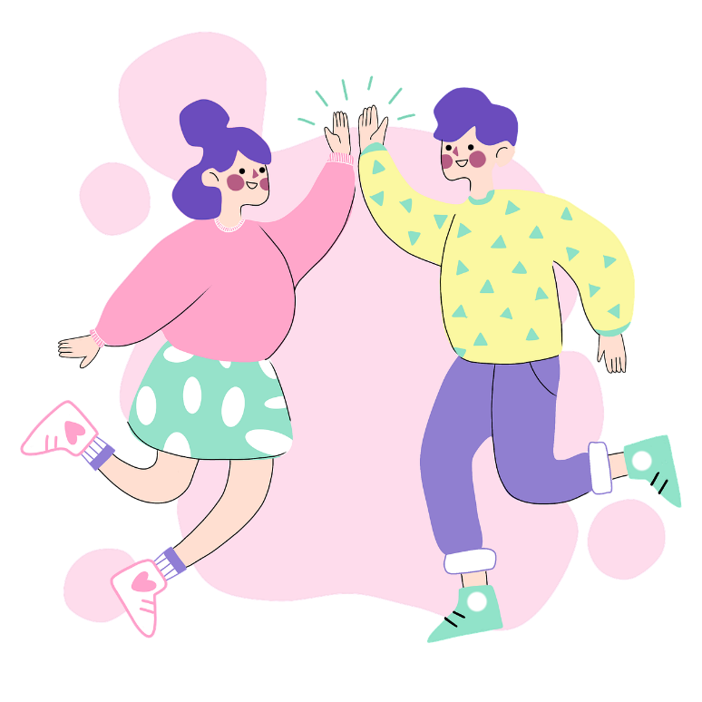
Uses of social media in the 21st century
Social media as a job: influencers
You probably already know what an influencer is, but we will give you a formal definition: an "influencer" or opinion leader is a person who has made social media their job, because of their lifestyle, beliefs or values, and who has a considerable number of followers or subscribers. This is one of the new professions that did not exist until 20 years ago, and which joins others such as "youtuber" or "streamer", although these are also usually considered influencers.

Slide 11
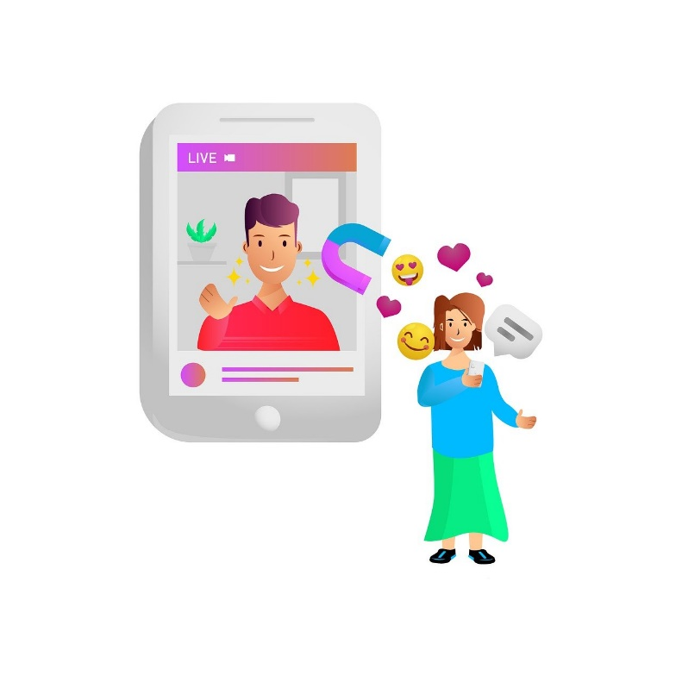
Uses of social media in the 21st century
Social media as a job: influencers
However, this is not such an easy and wonderful profession as it may seem; not everyone is able to make a living at it, and it is also mentally exhausting as you expose your entire daily life and leave your privacy behind.
You may follow or know some of the following examples:

Slide 12
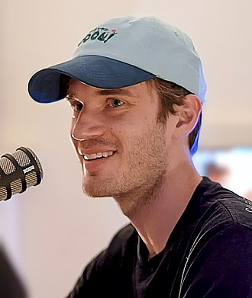
Uses of social media in the 21st century
Social media as a job: influencers
Examples of influencers:
PewDiePie. This Swedish youtuber has been active since 2010 and already has more than 110 million subscribers, making him one of the oldest youtubers on the YouTube platform, and also one of the best known. He is mainly dedicated to the creation of entertainment videos and video games. In 2016 he was listed by Time magazine as one of the 100 most influential people in the world.

Slide 13
Uses of social media in the 21st century
Social media as a job: influencers
Examples of influencers:
Chiara Ferragni. Italian influencer and entrepreneur who dedicates her content to fashion and lifestyle, she is also known worldwide, has almost 28 million followers on Instagram, and her blog "The Blonde Salad", active since 2009, registers thousands and thousands of visits every day.

Slide 14
The hidden side of social media
The risks of social media
Although social networks can bring many good things, it should not be forgotten that they have a hidden side in which there are numerous risks and dangers, such as:
Loss of privacy. Remember that everything you upload to the Internet is going to be recorded forever somewhere, so consider the importance of your privacy.
Social media addiction. It is important to set limits when using social media, because it can lead to a serious addiction that alienates you from the people around you physically.
Cyberbullying. Whenever you witness someone bullying someone else online (and in real life), you should report it to the authorities so that they can take appropiate action.

Slide 15
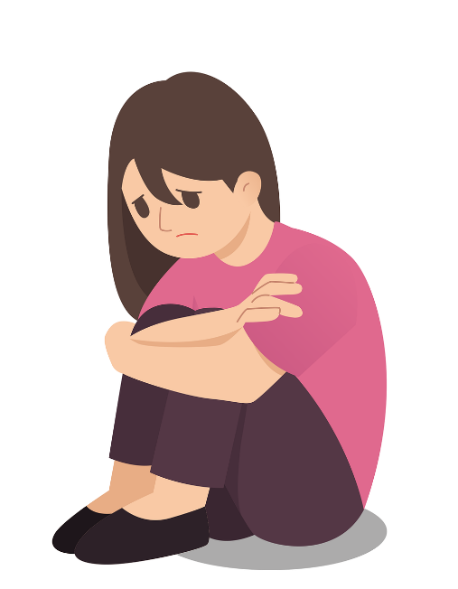
The hidden side of social media
The risks of social media
Extortion of any kind. Be careful about what you post on social media to avoid being extorted. If this happens to you, report it to the authorities.
Fake news. Don't be influenced by unreliable media reports, always try to check the information.
Reality distortion. Sometimes, social networks provide a false image of constant happiness that is unrealistic, and can lead to disorders that distort the reality you perceive.

Slide 16
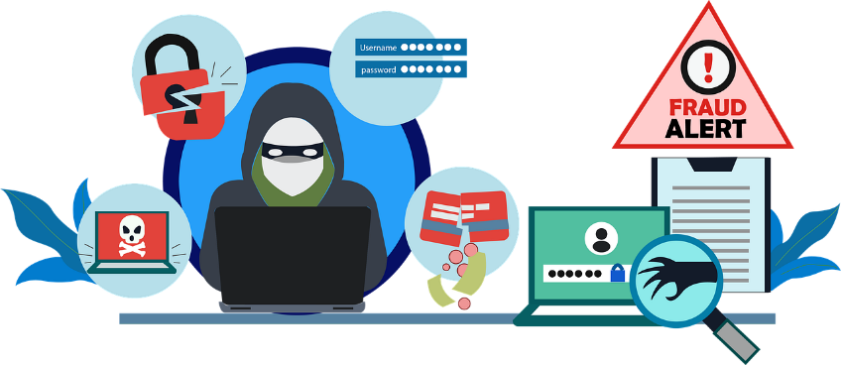
The hidden side of social media
Social media offences
Since there are many dangers, there are also offences on social networks that each country covers in its legislation, but which can generally be summarised as follows:
Phishing or impersonation. When you provide personal information on social networks, people may use it to impersonate you or someone else to obtain private information about other people. For example, there are people who use this technique to obtain sexual photographs to extort money from that person.

Slide 17
The hidden side of social media
Social media offences
Harassment and cyberbullying. This is a crime that happens more often than it should, through harsh criticism, threats, hurtful comments and continued harassment. Always consider that behind the screen, there may be a person who is suffering from these kinds of comments.
Defamation and slander. This offence concerns attacks on the honour and defamation of a person or company. Freedom of expression must be considered to have a limit, as it cannot be used as an excuse to attack others without consequences.

Slide 18
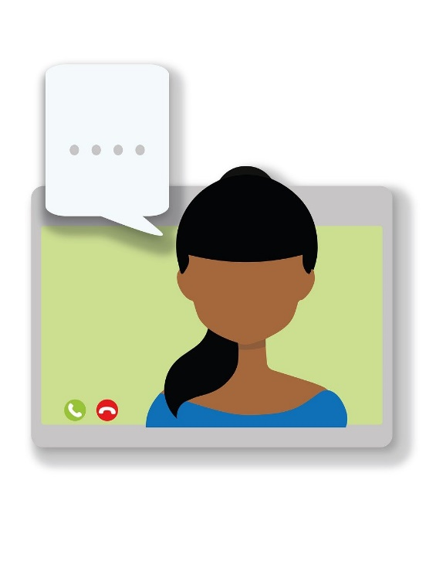
The hidden side of social media
Recommendations
Be wary of strangers.
Do not provide personal information such as your address or telephone number.
As far as possible, keep your accounts visible only to people you know by changing your privacy settings.
Check the rules of each social network; often rules are broken due to ignorance, for example with the minimum age for registration. Know your rights and obligations.

Slide 19
The hidden side of social media
Recommendations
Do not post intimate or private photos, or photos of other people without their consent.
Find out which authorities you should contact if you witness a crime on social media.
Report any offensive acts or possible crimes. Social networks also have the option to block accounts if you feel you are being harassed or attacked.

Slide 20
Quests
Based on what you have studied in this unit, can you solve the exercises in the following slides?
You will have to make decisions about complicated situations in which you will use the knowledge you have acquired.
Take decisions
Expand your thinking
You will have to open your mind and think as if you were really in that situation, using your best tool: your brain.

Slide 21
Quest 1: Using social media to get a job
Introduction: What’s this all about?
Let's talk about LinkedIn. This professional social network founded in 2002 by Reid Hoffman and Konstantin Guericke currently has more than 830 million members and more than 58 million registered companies.
LinkedIn is used to connect professionals and companies looking for job synergies and new business opportunities. Therefore, there are two types of profiles: the company profile and the user profile. In addition, there is a very interesting section dedicated to the job search, where hundreds of job offers are published daily and users can register for them.

Slide 22
Quest 1: Using social media to get a job
Task: What’s the activity?
In this activity, we will guide you through creating your own professional LinkedIn profile, so that you can use it to find job opportunities and boost your professional relationships.
It is very important to keep in mind that LinkedIn is a professional social network, so imagine you are in an office full of business people in suits. Wouldn't you behave in a proper and professional manner?

Slide 23
Quest 1: Using social media to get a job
Process: What am I going to do?
Go to https://www.linkedin.com/ and create an account. You can also download the app on Android or iOS on your smartphone or tablet. Add your personal information. When you click on join, your account is ready. Now the most important part begins: filling in your profile to make it professionally attractive. You may not have any work experience or education, but don't worry - that doesn't make you any less professional!
Complete your profile. Add a profile picture (don’t put a picture of your holidays at the beach!), add a good professional summary, your work experience and your education.
Interact with people to build professional relationships.
Some tips for managing your LinkedIn profile: be careful with your spelling, don't copy and paste the same information from your CV, don’t be shy, contact people in a polite and respectful way, and point out your good points.

Slide 24
Quest 1: Using social media to get a job
Learning outcomes: What will I learn?
Competence (LifeComp)
P1 Self-regulation.
S2 Communication.
L1 Growth mindset.
Competence (EntreComp)
2.1 Self-awareness and self-efficacy.
2.5 Mobilising others.
3.1 Taking the initiative.
Competence (DigiComp)
2.2 Sharing through digital technologies.
2.5 Netiquette.
2.6 Managing digital identity.

Slide 25
Quest 1: Using social media to get a job
Conclusion: What will I take home?
What did you think of this first contact with professional social networks? Now you have your own LinkedIn profile and can start finding your own job opportunities online.
Social media is a very interesting tool nowadays. New professions have even been created around them, such as the position of "Community manager". However, they can also work against you, so you should check what information is available about you online, as employers can also search for you and find information or photos that you might not want them to find. Take care of your privacy and your online reputation.
Finally, we recommend that you take a look at the resources section of this task, where you will find interesting links to pages and videos where you can take your knowledge of the subject further.
Continue your training! ;)

Slide 26
Quest 2: Social media for your digital business
Introduction: What’s this all about?
As you have studied, in recent years some jobs related to social media have been created in companies, such as community manager or social media manager, which are dedicated to managing the online presence of companies and their online communities. Social media is therefore an important and valuable tool for companies to interact with their target audience and gain more customers.
Surely in your daily life you use a social network, and you can take advantage of your knowledge, and the knowledge you will have acquired in this training, to transfer it to a real situation, just as an entrepreneur would do.

Slide 27
Quest 2: Social media for your digital business
Task: What’s the activity?
In this activity you will have to put yourself in the shoes of an entrepreneur. Imagine you have a company and identify the most appropriate social network(s) your company should have.
Once you have identified it, create an account as your own project, and create the corporate image of the company, as well as at least 3 publications that you would post if you had a company.

Slide 28
Quest 2: Social media for your digital business
Process: What am I going to do?
Imagine you have a business: choose the sector of activity, the products and/or services you offer, and the public you are targeting. It is important that you think about the needs that your company's audience may have, as well as their characteristics: what is their age range, do they come from urban or rural areas, what are their tastes?
Once you have identified your audience, examine the most popular social networks today, and think about where your audience might fit in. Do some research on the Internet, where you can find studies related to the characteristics of the users of each one.
Finally, create an account for your imaginary company and create your corporate image, as well as 3 publications. You can use tools like Canva (https://www.canva.com/) to design your logo and posts. Remember that the posts should emphasise the best of your products or services, but also bring something to the user, such as curiosities or entertainment. Check out the resources section!

Slide 29
Quest 2: Social media for your digital business
Learning outcomes: What will I learn?
Competence (LifeComp)
S2 Communication.
L1 Growth mindset.
Competence (EntreComp)
1.2 Creativity.
2.3 Mobilising resources.
3.2 Planning and management.
Competence (DigiComp)
1.3 Managing data, information, and digital content.
2.6 Managing digital identity.
3.1 Developing digital content.
5.3 Creatively using digital technologies.

Slide 30
Quest 2: Social media for your digital business
Conclusion: What will I take home?
What’s up? Did you find it interesting to put yourself in the shoes of an entrepreneur with a business in the digital world?
Practical exercises of this type allow you to effectively learn what you would do in a real job, whether you are the community manager of a company, or whether you are setting up your own business and want to have an online presence through social media.
Remember that you can consult the resources section associated with this task to learn in more depth, and find out the tips and tricks that will allow you to carry it out more effectively.

Slide 31
Self-assessment
Multiple-choice questions: consolidate your learning
Question 1: Which of the following social networks is oriented towards networking?
a) Reddit.
b) LinkedIn.
c) TripAdvisor.
d) All answers are correct.
Question 2: Which of the following is a risk arising from the use of social media?
a) Reality distortion.
b) Loss of privacy.
c) Addiction.
d) All answers are correct.
Question 3: What should you do if you detect a case of cyberbullying?
a) I shouldn't intervene, it's none of my business.
b) Insulting the cyberbully.
c) Notifying the authorities.
d) All answers are correct.

Slide 32
Self-assessment
Multiple-choice questions: consolidate your learning
Question 4: What is the role of a community manager?
a) Management of a company's e-commerce.
b) Management of a company's social networks.
c) Management of a company’s customers.
d) All answers are correct.
Question 5: How can social media help you?
a) Finding a job.
b) Keeping in touch with a friend in another country.
c) Making professional contacts (networking).
d) All answers are correct.

Slide 33
Self-assessment
Multiple-choice questions: solutions
Question 1: Which of the following social networks is oriented towards networking?
a) Reddit.
b) LinkedIn.
c) TripAdvisor.
d) All answers are correct.
Question 2: Which of the following is a risk arising from the use of social media?
a) Reality distortion.
b) Loss of privacy.
c) Addiction.
d) All answers are correct.
Question 3: What should you do if you detect a case of cyberbullying?
a) I shouldn't intervene, it's none of my business.
b) Insulting the cyberbully.
c) Notifying the authorities.
d) All answers are correct.

Slide 34
Self-assessment
Multiple-choice questions: solutions
Question 4: What is the role of a community manager?
a) Management of a company's e-commerce.
b) Management of a company's social networks.
c) Management of a company’s customers.
d) All answers are correct.
Question 5: How can social media help you?
a) Finding a job.
b) Keeping in touch with a friend in another country.
c) Making professional contacts (networking).
d) All answers are correct.

Slide 35
Summing up
Social media
Uses of social media
Social networks can be used for all sorts of things: entertainment (Twitch, YouTube), contacting people (Facebook), professional contacts (LinkedIn), finding hotels (TripAdvisor)...
Social networks can be for personal use, for business use through community managers who manage them, and they can even become a job, as in the case of influencers.
A
B
C
D
The hidden side of social media
Cautions and recommendations
Social networks have a dark side, where there are dangers to avoid, such as addiction or distortion of reality.
You should check the rules of each social network, do not post personal information, and be wary of any signs of crime.

Slide 36
Thank you!
Continue your training path at www.projectspecial.eu!

