Slide 1
2D and 3D
Design
By: HAC
The European Commission’s support for the production of this publication does not constitute an endorsement of the contents, which reflect the views only of the authors, and the Commission cannot be held responsible for any use which may be made of the information contained therein.

Slide 2
Index
01
Introduction
What is Fablab/
02
Software to draw
2D and 3D drawing
03
Inkscape
Learn to know the most important tools
04
3D drawing – Altering 3d & design
03
Tinkercad and Meshmixer
05
Quest and self assessment

Slide 3
What is FabLab?
is a place to play, to create, to mentor and to invent: a place for learning and innovation.
If you have a FabLab close by you can use these instructions to guide you in your first steps. You can also use these
instructions at home with
your own computer for your own projects.
“Give ordinary people the right tools, and they will design and build the most extraordinary things.” – Prof Neil Gershenfeld, MIT

Slide 4
FabLab
FabLab
1
Fab Lab comes from the English words Fabrication Laboratory, a kind of manufacturing laboratory. Fab Lab has its roots in the Center for Bits and Atoms at MIT University in Massachusetts, USA. That institute is headed by Professor Neil Gershenfeld who, in addition to conducting extensive research in this field, teaches a course at MIT called How to Make (Almost) Anything.
Fab Lab (Fabrication Laboratory) is a workshop with equipment and tools to make almost anything. The Fab Lab workshop gives young and old, individuals and companies, the opportunity to train their creativity and implement their ideas by designing, shaping and producing things with the help of digital technology.

Slide 5
FabLab
1
We want to be doers in the digital future. We want to create new jobs, new opportunities and activate the possibilities offered by new technologies.
Radical changes in society and the economy call for changes in education. Education and skills in trades, science and technology are an important basis for innovation.
Fab lab is an open platform for the public, companies, entrepreneurs, and students.
Fab Lab is a workshop with devices and tools to make almost anything.
In FabLab include; computerized laser cutters, vinyl cutters, milling machines, 3D scanners and 3D printers

Slide 6
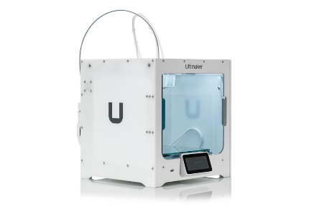
FabLab
1
What equipment is in Fab Lab workshops?
All Fab Lab workshops are equipped with various types of equipment to generate all kinds of ideas.
All workshops have laser cutters, large milling machines, fine milling machines, 3D printers, electronics workshops, have 3D scanning facilities, remote conferencing equipment and 2D and 3D design equipment along with programming equipment.

Slide 7
2D and 3D drawings
2
2
What is the difference?
3D (three-dimensional) drawings
describe objects in terms of height, width and depth.
2D (two-dimensional) drawings
describe objects in terms of length and height on a flat surface without depth.

Slide 8
Software to draw
2
Many options are for software to draw such as:
3D drawing
2D drawing
Inkscape
Tinkercad
Easy desktop app for creating cutting files
A free web app for 3D design, electronics, and coding
Gimp
Meshmixer
GIMP is a image editor. It is free software,.
a free and open-source 3D computer graphics software tool

Slide 9
What is Inkscape?
3
Inkscape is a professional quality vector graphics software
Inkscape is free and open source and can be found at:
https://inkscape.org
Widely used for both artistic and technical illustrations
such as cartoons, clip art, logos and typography
It uses vector graphics to allow for sharp printouts and renderings at unlimited resolution
Inkscape uses the standardized SVG file format as its main format
They do not loose any quality if they are zoomed or resized
You can import and export various file formats, including SVG, AI, EPS, PDF, PS and PNG.

Slide 10
Get to know Inscape
Keyboard Shortcuts for Inkscape
There are many shortcuts, commands you can learn as you go along.
This software has many possibilities.
Take one step at the time.
First lets get an overview of the software and its basics
Often there are more than one ways to achieve the same result.
Try them as we go along and then check out our quests.
Soon you will develop your own habits and preferences for drawing with Inkscape.

Slide 11
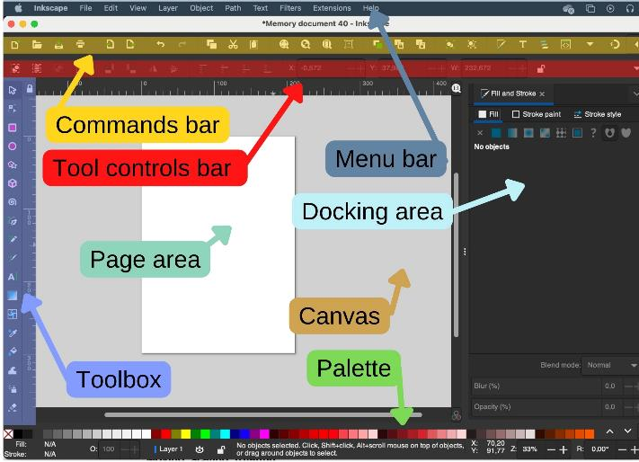
Menu bar: along the top, general menu options
Commands bar: quick access to common commands.
Toolbox: on the left, main drawing tools. Only one tool can be used at once.
Tool controls bar just below to adjust the currently selected tool
Canvas : the large blank area where the image is edited.
Page area: A black/white outline represents it
Docking area: dialogs for specific functionality

Slide 12
Ways of Drawing in Inkscape
Inkscape offers several ways for creating vector images, which can, of course, be combined:
using the geometric shape tools
using the path tools, much like a pencil on paper
using one of the many available features that let you create elements of a drawing automatically
starting from a photo, a scanned/copied image or any raster graphic by using a tracing engine

Slide 13
The Shape Tools
The Shape Tools is used to create a geometric shapes:
Squares and Rectangles
Start by selecting the tool in the toolbar by clicking on it. Then press the mouse button and hold while you drag the mouse on the page area. Then release the mouse button to display the shape.
Once the mouse button is released and the shape is displayed, various handles will become visible. Many of Inkscape’s tools use handles for one purpose or another.
Circles, Ellipses and Arcs
Stars and Polygons
3D-Boxes
Spirals

Slide 14
Free Drawing
Pencil, Pen and Calligraphy tools
Bezier curves and straight lines
With some practice, you will get better and better in achieving exactly the result that you desire.
Freehand lines
The freehand drawing tools make it possible to draw directly onto the Inkscape canvas.
Depending on what and how you would like to draw, you can select the best tool for the task.
These tools are not based on geometrical shapes. You can draw exactly the shape you need. And of course, you can always modify the elements in your drawing with the path tools.
Calligraphy or brush strokes

Slide 15
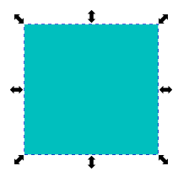
The Selector Tool
Transformations (such as moving, scaling, rotating) are easy thanks to the two-way arrows.
Select and transform objects
Select all objects or all nodes
Click once to scale and skew
Click twice to rotate
To select more than one object:
press the mouse button and drag out a selection box with all the objects.
To scale (change the size of) an object:
click on it to select it; then press the mouse button a two-way arrow on a side or a corner and hold while dragging it to the desired size
If you want to preserve the proportions hold Ctrl or use the lock in the tools control bar
.

Slide 16
Editing Paths with the Node Tool
The position of a node is shown as a square, circle or a diamond handle on the path.
The Node tool is used when you need to edit a path.
A path’s shape can be changed by moving the nodes it consists of:
First activate the Node tool.
Then click on the path to select it.
Then you can click and drag the node you wish to put in a new place.
The paths are made of connected nodes, like pearls on a string.
.

Slide 17
Important Node Tools
Delete segment between two non-endpoint nodes
If you want to insert new nodes just double-click at the segment they are supposed to be.
To delete unwanted nodes just click on them and then either right click and chose “Delete” in the menu or simply use the “Delete”-key on your keyboard.
Join selected end nodes with a new segment
Break path at selected nodes
Join selected nodes
.

Slide 18
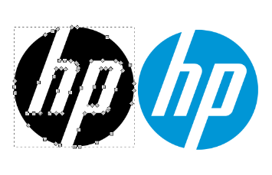
Changing an image into a vector
Making use of “Trace Bitmap”
If you want to use a picture/drawing/ clipart from the internet, “Trace Bitmap” is the right tool.
The image chosen has to be active (you’ll see a frame around the pic).
Choose “Path” and then “Trace Bitmap” in the dropdown menu.
A new window opens and where you can choose the method of scanning. Standard choice is “Brightness cutoff” with threshold of 0.450. If you raise the number the image will get darker, if you lower it will take less color.
When happy with the image just hit “OK” to get the vector image.
Now just drag the new image off the original one and start editing.
Vector with nodes vs. original image
.

Slide 19
Adding text to your image
Give your design a personal touch
A step to giving your work an individual touch is by adding some text.
This icon enables writing. Just click anywhere in your workspace and start writing. Keep in mind not all fonts are good for laser/vinylcutting, especially those with very fine lines can be difficult to handle.
When using a laser cutter remember to connect all parts that otherwise would just fall out of your design (see image)
Text for vinylsticker vs. text for lasercutter when cutting and removing the letters (leave holes where the letters are, e.g. when using as a sign with backlight)
.

Slide 20
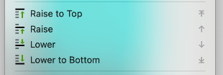
Stacking Order
What should be up front and what's in the background
In Menu bar Object
Stacking Order
If you have drawn objects that overlap each other, you can select an object and then click “Raise” or “Lower” under the “Object” menu to change the stacking order.

Slide 21
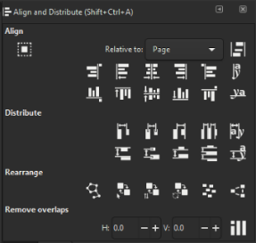
Align and Distribute
Putting things in places
In the dropdown menu "Object" you find the item "Align and Distribute"
It's used to arrange items in your worksheet.
This comes in handy when you want to put a text straight under a pic or arrange objects at the same bottom line.

Slide 22
Boolean Operations
Different ways to put paths together
Union
Keeps the common outline of all selected paths.
Difference
Subtracts one path from another one.
Intersection
Only keeps those parts that are covered by all selected paths.
Exclusion
Keeps those parts which are covered by an odd number of paths (if you have two objects, this is where the objects do not overlap).
Division
The path below is cut into pieces by the path above.
Cut Path
Creates as many paths as there are path intersections between the two paths.
Combine
Keeps all parts and combines them into a single object.
Break Apart
If a path consists of a number of independent parts (subpaths), this will create that number of separate objects.

Slide 23
Colors
Colors of objects can be added and changed at any time
You find the dock for "Fill and Stroke" under the menu item "Object".
For a vector object, a separate style can be defined for its outline (or stroke) and its main color (or fill).
This can be a plain color (e.g. dark red), a pattern (e.g. stripes or flowers), or a gradient (e.g. a smooth transition from green to blue).
When creating files for vinyl/laser cutting (for FabLab use) we have to keep in mind to set the stroke paint to plain color, red 255, the stroke style to 0.02mm width and remove the fill.

Slide 24
Tinkercad
4
3D drawing
Learning by doing
A free web app for 3D design, electronics and coding
Power up your imagination
Great for beginners
For all ages
Easy and full of video guides
Ad-free and kid safe
You simply sign in
From mind to design in minutes
Make your own account
If you can dream it, you can build it

Slide 25
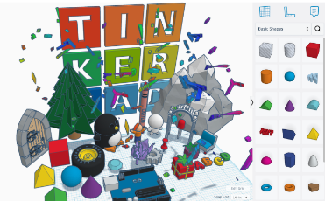
Simply sign in
Tinkercad
Tinkercad is a 3D CAD program from Autodesk that is easy to use and suitable for e.g. designing small simple parts for 3D printing.
In the Fab Lab workshops, Tinkercad is mostly used to design objects in 3D to be printed on a 3D printer. In Tinkercad you can also import files on e.g. .svg format and convert to 3D and you can also import 3D files in .obj or .stl format and continue working with those files in Tinkercad.
The program is in the on the web and can be used with a browser at https://www.tinkercad.com/.
Teachers can get a special access code that they can pass on to their students in order to use the application.

Slide 26
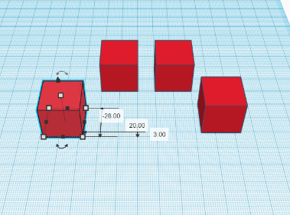
Endless possibilities
Tinkercad
Basic models such as name tags, furniture,
houses, snowmen, vases, keychains, and
cups are easy to create quickly with
Tinkercad.
Design by selecting, dragging, and placing
basic shapes and then combining and
manipulating them to create 3D models of
whatever you like.
If you make your designs public then other
people can open their own copies of your
models and Tinker with them; likewise, you
can Search through thousands of public models to find designs to Tinker with and modify.

Slide 27
Tinkercad
Possibility is limitless

Slide 28
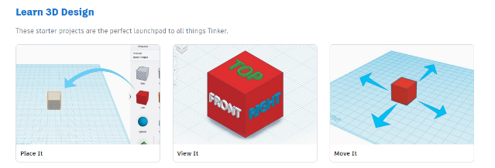
Tinkercad
Learning center
After you have signed in on Tinkercad you can go to Resources on top of the page and chose Learning center (tinkercad.com/learn). In the learning center you can get started learning how easy and fun Tinkercad really is.
There are three different methods with video tutorials:
Learn 3D Design
Learn Circutits
Learn Codeblocks

Slide 29
Tinkercad
Design on the go with ipad app
Instead of a mouse, all you need is your fingertip.

Slide 30
Meshmixer
4
3D modelling
Big community
A free desktop app for shaping/combining 3D designs
Loads of tutorials and easy to follow videos
Easy to start with
Very compatilble
Just modify already existing models in easy steps
Supports the most common mesh formats
Download and start
Fast results
Works on Windows and MacOS
From idea to printfile in a few minutes

Slide 31
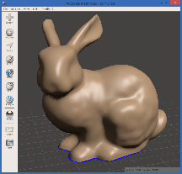
Just download and start
Meshmixer
Meshmixer is another 3D program from Autodesk. It's easy to use and well suited for preparing existing files for 3D printing. It works with the most common mesh formats (.stl, .obj, .ply, .amf, .3mf, .off and .mix), which opens a whole new world of accessible 3D models online. Download the desired file(s), adjust to your wishes and you are good to go.
The program has to be downloaded to your computer. It's suitable both for Windows and Mac OS. Download here: https://meshmixer.com/
Meshmixer is not longer in development, but won't retire anytime soon. Most features are available in Fusion360, too. Fusion 360 is fee-based.

Slide 32
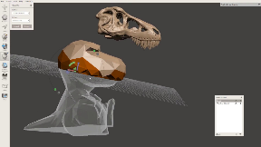
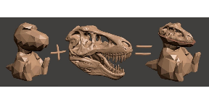
Endless possibilities
Meshmixer
Opposite to Tinkercad you don't create
shapes in Meshmixer but alter and combine
ready designs.
There's a huge amount of printable designs online, a good free selection to be found at https://www.printables.com/
Combine different designs, vary size and
structure at your likings. No limits!
With the included Inspector-tool you can detect faulty areas, define the problem and repair in one step to make your design printable.

Slide 33
Meshmixer

Slide 34
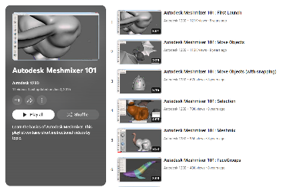
Meshmixer
Tutorials
There is a big community using Meshmixer and uncountable tutorials online, everything from the very start to advanced models. Autodesk itself hosts a Meshmixerforum. Tutorials:
All3DP
Solidprofessor
101 Meshmixer (YouTube)

Slide 35
Other programs
Sketchup
Vectary
create architecture, interior design, craft and more
Easy to use
Blender
3D Builder
Great for animations
Included in Windows
3D Slash
Fusion360
Available for online design
Powerful program, free for students and personal use.

Slide 36
Quests
Based on what you have studied in this unit, can you solve the exercises in the following slides?
You will get to know the software by trying this out.
Take decisions
Expand your thinking
Just take one step at the time

Slide 37
Quest 1: Easy text on path 1
Introduction: What’s this all about?
Task: What’s the activity?
Now you have seen the basics of Inkscape. Lets try it out. This way you will get to know the software one step at the time.
How to make a sign/sticker with your name on it

Slide 38
Quest 1: Easy text on path 2
Learning outcomes: What will I learn?
You will get more familiar with Inkscape, learn how to use the tool to make text

Slide 39
Quest 1: Easy text on path 3
Process: What am I going to do?
Open Inkscape and hit the "A" in the taskbar on the left side. It's to create and edit text.
Now you can draw a frame wherever you like on your page. You are going to write into that frame.
Double click and write your name. The font doesn't matter right now.
Now choose a font you like in the Tool controls bar.

Slide 40
Quest 1: Easy text on path 4
Process: What am I going to do?
4. Now choose a font you like, but no handwriting or script as the vinylcutter would cut your sticker into pieces instead of having a whole piece.
I chose "Dragonfly". There are a lot of free fonts online e.g. at www.1001freefonts.com.

Slide 41
Quest 1: Easy text on path 5
Process: What am I going to do?
5. Next step is to draw a path to put your text on. The path will define to form your text gets.
You can choose between drawing a path yourself or using a predefined form like a circle, ellipse, star, rectangle or even a spiral. The icons are in the taskbar on the left. Don't be shy to try out different types.

Slide 42
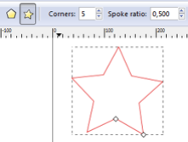
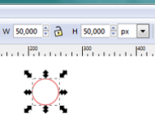
Quest 1: Easy text on path 6
Process: What am I going to do?
If you want to get a perfect circle, make sure to have the same value in the fields "W" (width) and "H" (height). If necessary, open the padlock and then close it again after changing the values to make sure to keep the right aspect ratio.
When drawing a star or polygon you can among other things choose the number of corners.
Choose at least 2 forms to try out, maybe a predefined and a hand drawn.

Slide 43
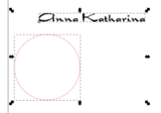
Quest 1: Easy text on path 7
Process: What am I going to do?
7. Select your text, copy and paste it in your document.
Pick your text and then hold the SHIFT-button to select the form/path you want to put your text on.

Slide 44
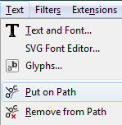
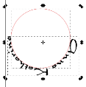
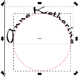
Quest 1: Easy text on path 8
Process: What am I going to do?
8. Go to the taskbar on top, choose "Text" and "Put on path" in the dropdown menu.
Now your text and form are combined. You can move the text away from the path, but it will keep its new form. If you are not happy with the look, you can move the text with the spacebar or in my case just turn the form with the handles until everything is the way you want it to be.

Slide 45
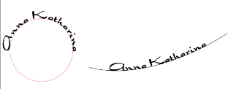
Quest 1: Easy text on path 9
Process: What am I going to do?
9. Then put the other text on another path. Compare your results and then choose which one you want to keep.

Slide 46
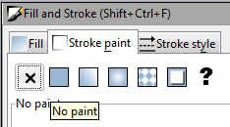
Quest 1: Easy text on path 10
Process: What am I going to do?
10. As you don't want the vinylcutter to cut the line/path, too, you have to make it invisible. If you delete the path, the text will return to its previous form.
To make the path invisible, hit "Fill and Stroke" and then mark the "X" at "Stroke paint".

Slide 47
Quest 1: Easy text on path 11
Conclusion: What will I take home?
Now its time to save and close your file

Slide 48
Quest 2: Change a bitmap into a vector graphic
Introduction: What’s this all about?
Task: What’s the activity?
In this quest we will continue to use Inkscape and learn about its possibilities by using it.
In this quest you will change a bitmap into a vector graphic, that is to change a simple online photo into a vector graphic.

Slide 49
Quest 2: Change a bitmap into a vector graphic
Process: What am I going to do?
Learning outcomes: What will I learn?
Follow these instructions and make a simple vector for your self.
You will learnn how to change a bitmap into a vector graphic.

Slide 50
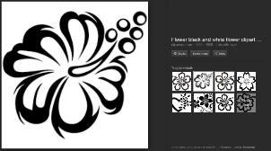
Quest 2: Change a bitmap into a vector graphic
Process: What am I going to do?
Find a picture on the internet via a search engine like Google. Best for the start is to search for cliparts or
logos in just 2 colours e.g. black and white.
For example I searched for „flower clipart black white
When choosing a pic, take care it is in sufficient size The bigger the more details you get when tracking the bitmap in Inkscape.

Slide 51
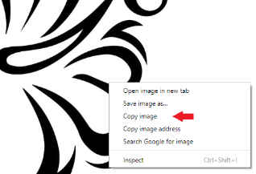
Quest 2: Change a bitmap into a vector graphic
Process: What am I going to do?
Open the pic with the „View Image“ button. You get it in a better resolution there.
Copy the pic. Attention: if the pic is a .png file, please safe the file to your computer instead of copying it. If you just copy it, you‘ll get a black rectangle instead of the pic when pasting it to Inkscape.

Slide 52
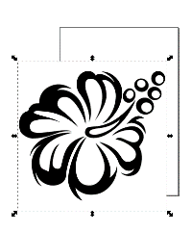
Quest 2: Change a bitmap into a vector graphic
Process: What am I going to do?
Open Inkscape and paste the pic.It doesn‘t matter if the pic fits on the page displayed in Inkscape or not. No need to change the page layout.

Slide 53
Quest 2: Change a bitmap into a vector graphic
Process: What am I going to do?
Make sure your pic has the frame like shown above. This means the pic is „active“ and we can work with it. If you want to change size by pulling the handles, take care to close the lock shown on the pic below.
When this is locked, both height and width change at the same time, keeping the pic at the right aspect ratio.

Slide 54
Quest 2: Change a bitmap into a vector graphic
Process: What am I going to do?
If you‘d like to zoom in or out, use the zoom at the very right lower corner.

Slide 55
Quest 2: Change a bitmap into a vector graphic
Process: What am I going to do?
Next (after making sure your pic is active) you open the pull down menue „Path“ and click on „Trace Bitmap“.

Slide 56
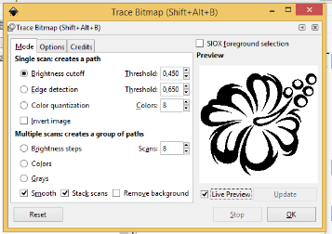
Quest 2: Change a bitmap into a vector graphic
Process: What am I going to do?
A new window opens. Tick off the box at „Live Preview“ so you can see the changes in your pic when you change the value in „Threshold“. With clear pics like our example it is best to use „Brightness cutoff“ to change it into a vector graphic. The standard value at „Threshold“ is 0,450. If you increase the number, the pic gets darker, taking in more details. If you decrease it, there will be less details, but less interruption if you take a more complicated pic in different colour. Best try out a few different settings and decide then, which fits best for you at that very moment. When you are happy with the preview, hit the OK button.

Slide 57
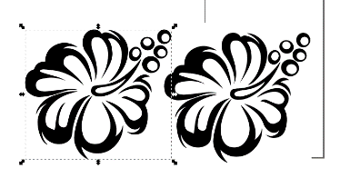
Quest 2: Change a bitmap into a vector graphic
Process: What am I going to do?
Now your vector graphic is above your original pic and you have to move it to the side to see the results. You should have gotten a pic with clearer outlines, no pixels.

Slide 58
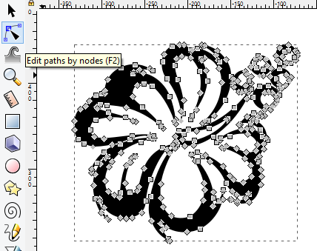
Quest 2: Change a bitmap into a vector graphic
Process: What am I going to do?
If you are content with the results, delete the original pic. In case you are not sure which is the vector graphic and which the original hit the button „Edit paths by nodes“ and click on the pic. If it‘s the vector, you‘ll get a lot of little nodes(boxes) on it.

Slide 59
Quest 2: Change a bitmap into a vector graphic
Process: What am I going to do?
If you want, you can delete nodes in order to get a smoother pic. To do so, click on the node you‘d like to delete and hit the delete button on you keyboard. The blue/yellow node on the pic is active. You can delete it or move it around.

Slide 60
Quest 2: Change a bitmap into a vector graphic
Process: What am I going to do?
When the pic is the way you want it, you have to take the fillcolour and set the strokecolour instead to see which lines you vinylcutter would cut later on. To get to the „Fill and Stroke“ menu, choose „Object“ in the taskbar.

Slide 61
Quest 2: Change a bitmap into a vector graphic
Process: What am I going to do?
A new window opens with 3 charts on it. The first one is „Fill“, then „Stroke paint“ and the last one „Stroke style“. We are going to use the first two. In „Fill“ you choose the X, which means, „no fill“. Your pic seems to disappear. Then you change to the next flip „Stroke paint“ and choose the completely filled box. Now the outlines of your pic should appear again.

Slide 62
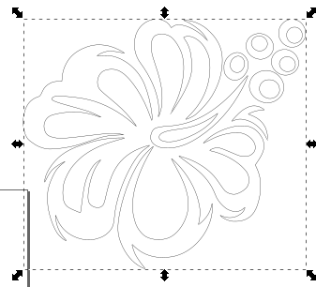
Quest 2: Change a bitmap into a vector graphic
Process: What am I going to do?
That‘s the way our sample pic looks like now. It‘s ready for the vinyl cutter. Please keep in mind to save your progress so it won‘t be lost if something unexpected happens during work.

Slide 63
Quest 2: Change a bitmap into a vector graphic
Process: What am I going to do?
If you delete something by accident or are not happy with the changes you made, use the „Undo-button“ or the shortcut „Ctrl+Z“

Slide 64
Quest 2: Change a bitmap into a vector graphic
Conclusion: What will I take home?
Now its time to save the file and use our image in your work

Slide 65
Self-assessment
Multiple-choice questions: consolidate your learning
Question 1: What is fablab:
a) A place to play
b) A place to create
c) A place to learn and invent
d) All above
Question 2: In Inkscape you can only do 2d design:
a) Right
b) Wrong
Question 3: In Inkscape you can…
a) Use any picture on the internet
b) Only use your own pictures
c) Best is to use clipart with only two colors
d) You can’t use pictures

Slide 66
Self-assessment
Multiple-choice questions: consolidate your learning
Question 4: Tinkercad is:
a) For professionals
b) Deigned for kids
c) For all ages and all stages
d) For beginners
Question 5: In Meshmixer you:
a) Build shapes
b) Alter and combine ready designs
c) Draw 2d designs
d) Need to be a professional

Slide 67
Summing up
Fablab
Tinkercad
Fab Lab (Fabrication Laboratory) is a workshop with equipment and tools to make almost anything.
Tinkercad is a 3D CAD program from Autodesk that is easy to use and suitable for e.g. designing small simple parts for 3D printing.
A
B
C
D
Meshcmixer
Inkscape
Opposite to Tinkercad you don’t
create shapes in Meshmixer but
alter and combine ready designs.
Widely used for both artistic and technical illustrations
.

Slide 68
Thank you!
Continue your training path at www.projectspecial.eu!

